Slide 1

Little Learner Artists
Coloring Book

Slide 2
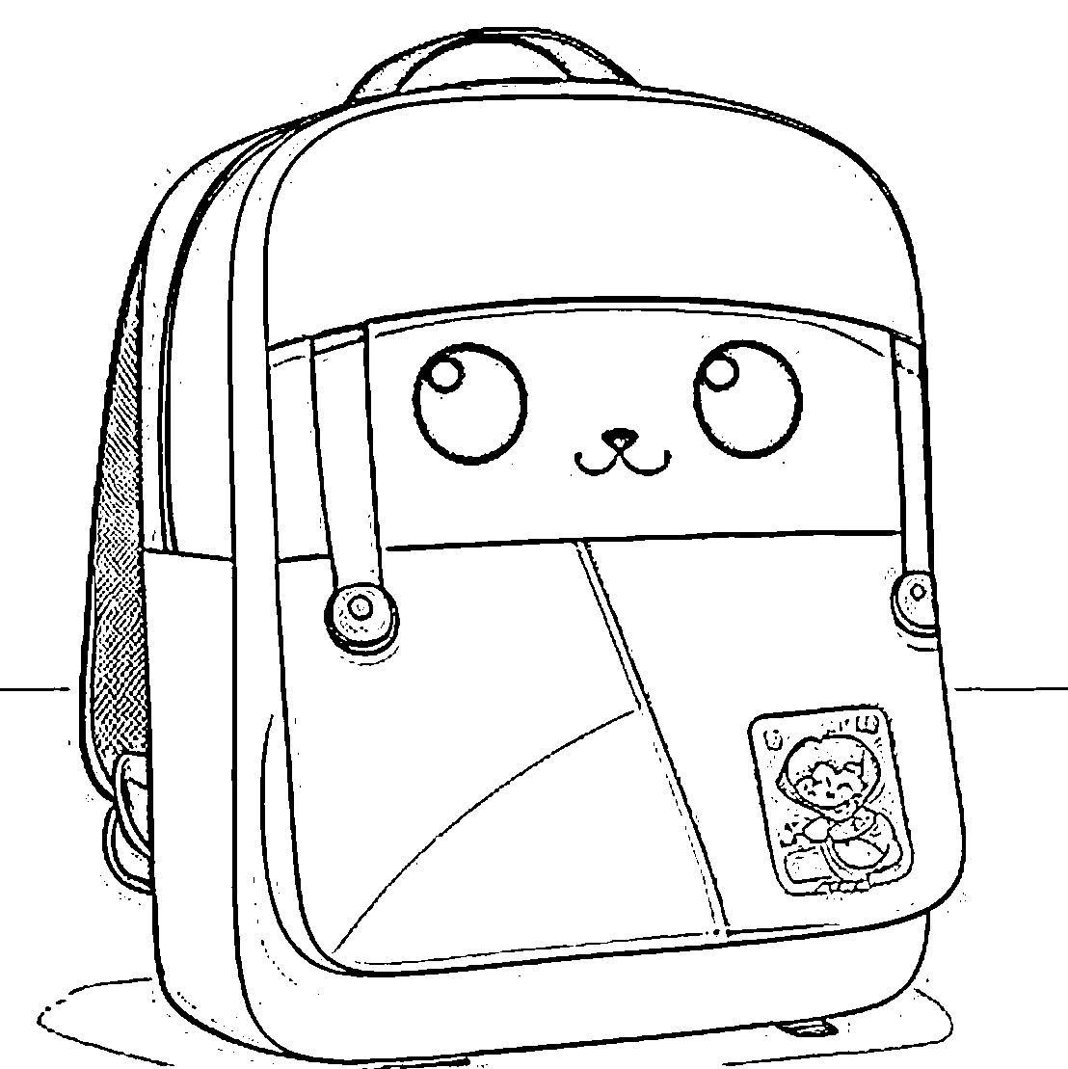

Trace & Color
My School Bag
Bag

Slide 3
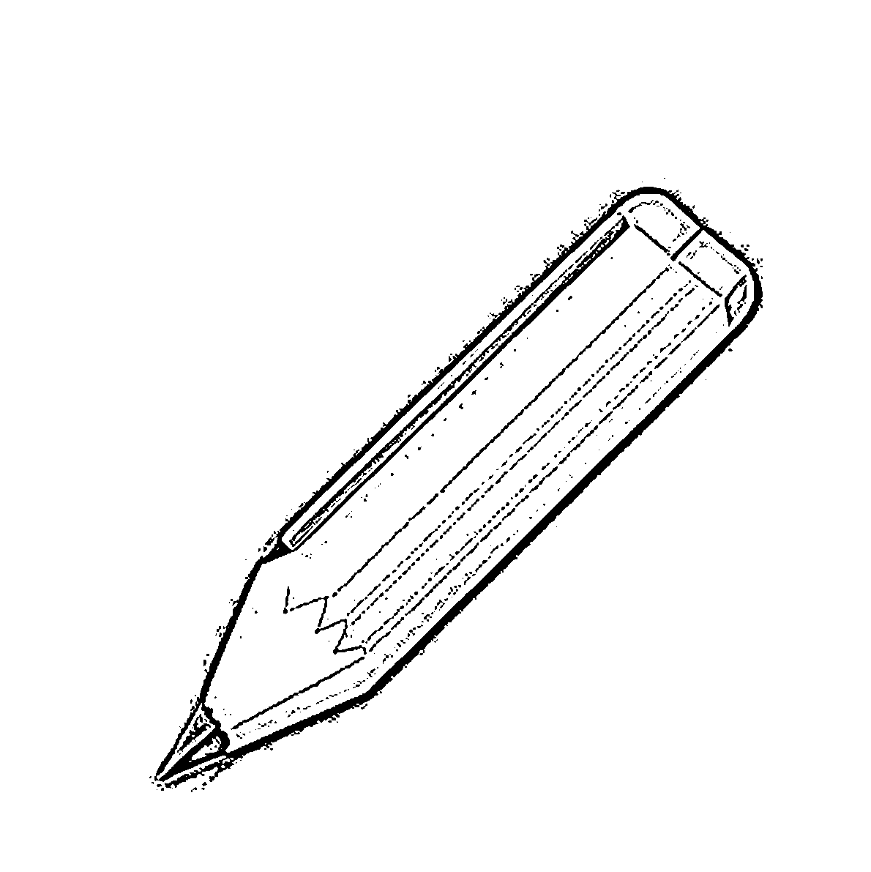


Trace & Color
My School Bag
Pencil

Slide 4
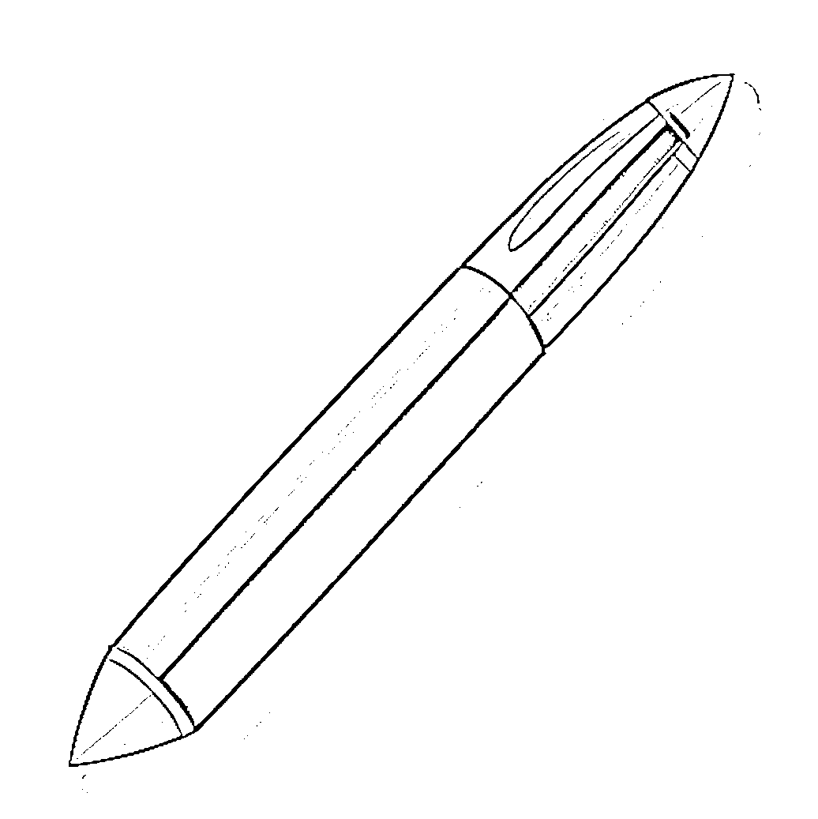

Trace & Color
My School Bag
Pen

Slide 5
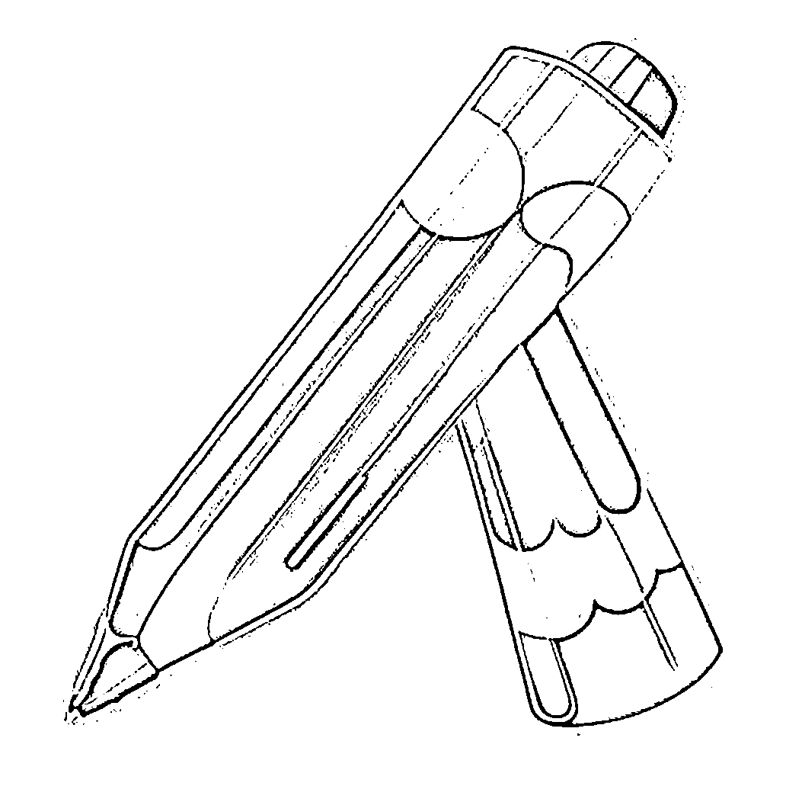

Trace & Color
My School Bag
Colored Pencil

Slide 6
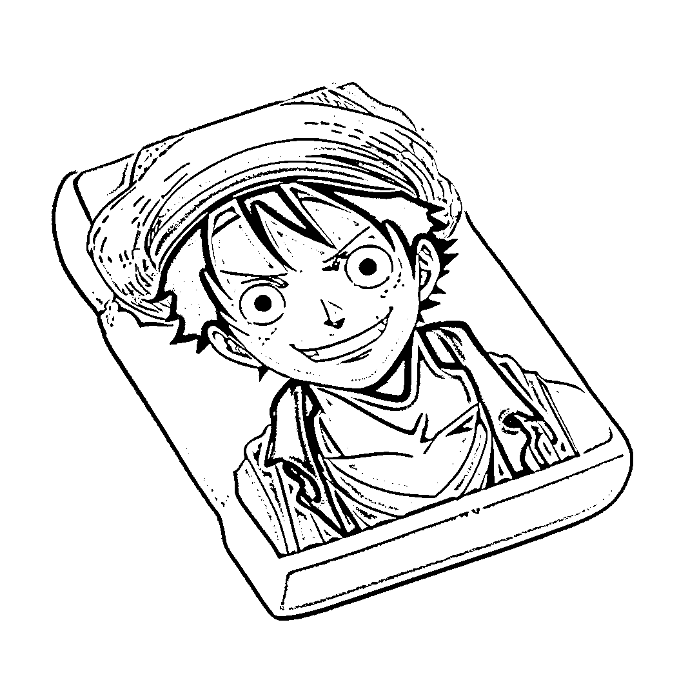
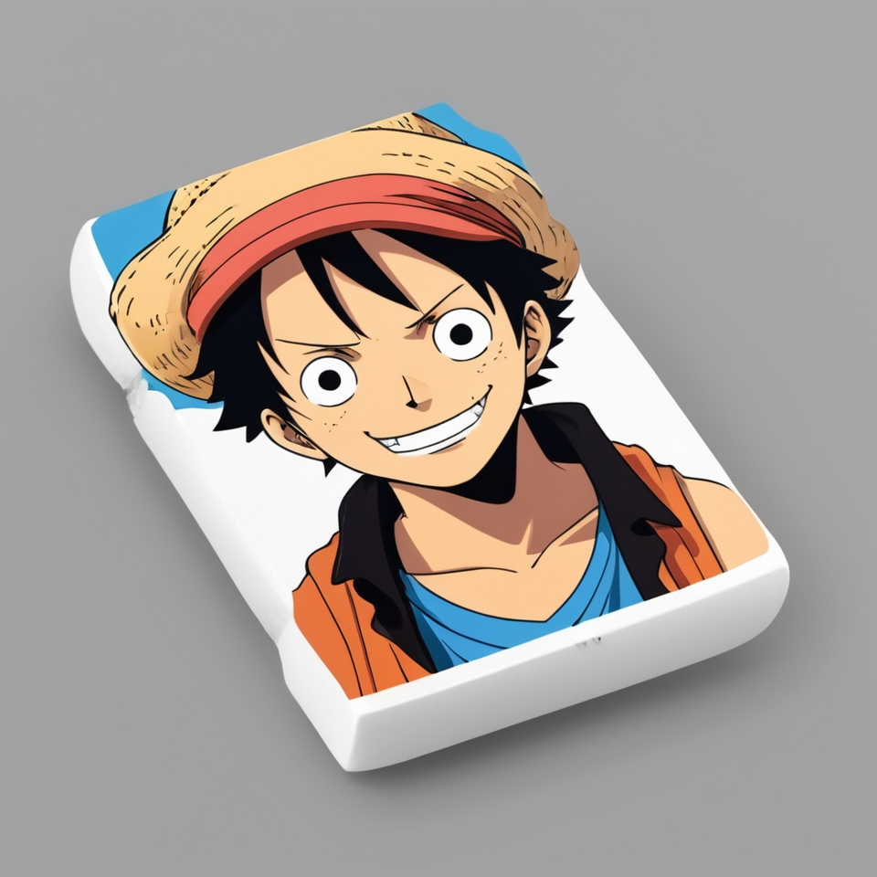

Trace & Color
My School Bag
Eraser

Slide 7
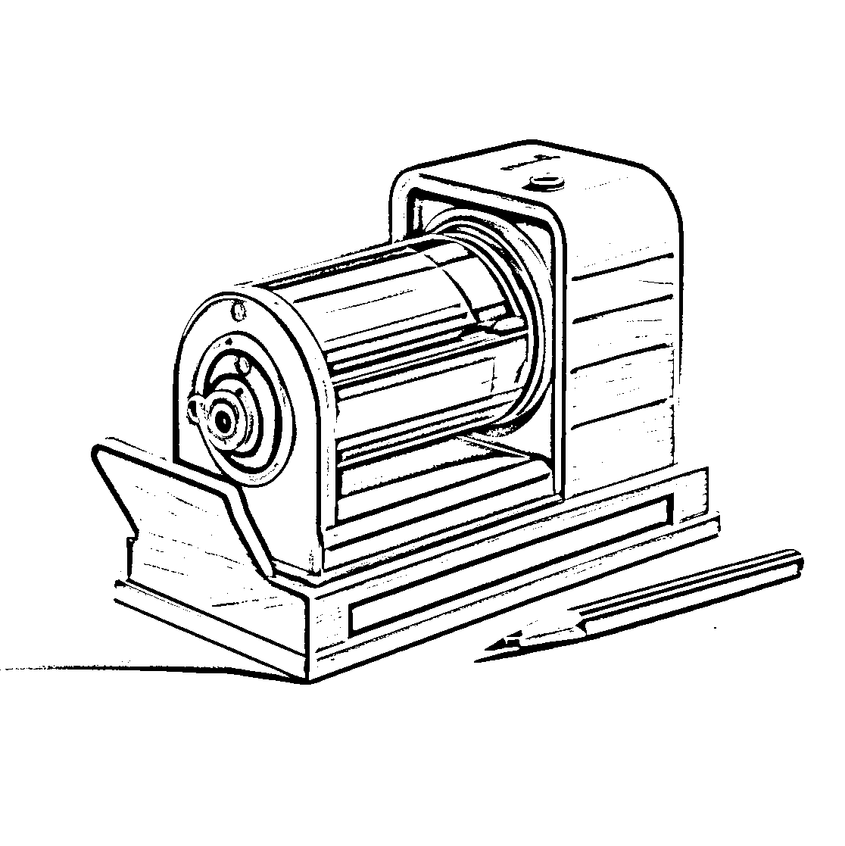
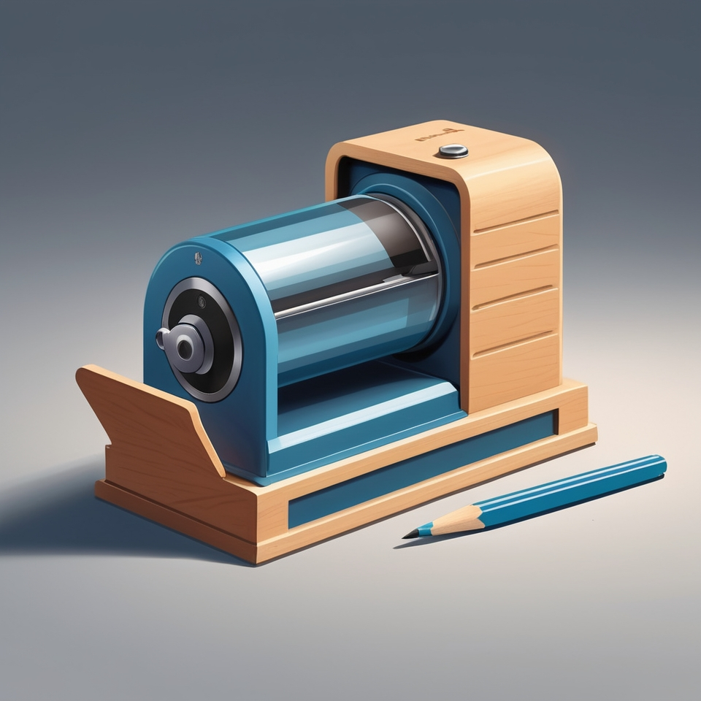

Trace & Color
My School Bag
Sharpener

Slide 8
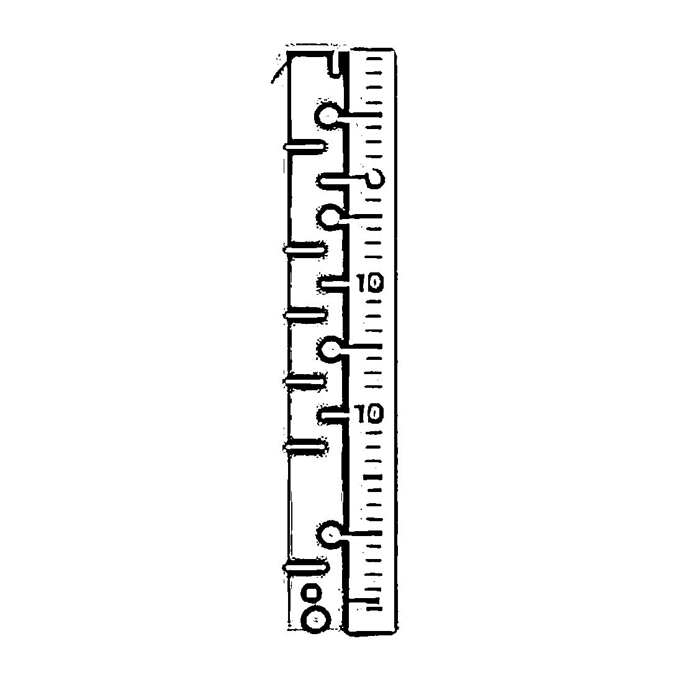

Trace & Color
My School Bag
Ruler

Slide 9


Trace & Color
My School Bag
Book

Slide 10
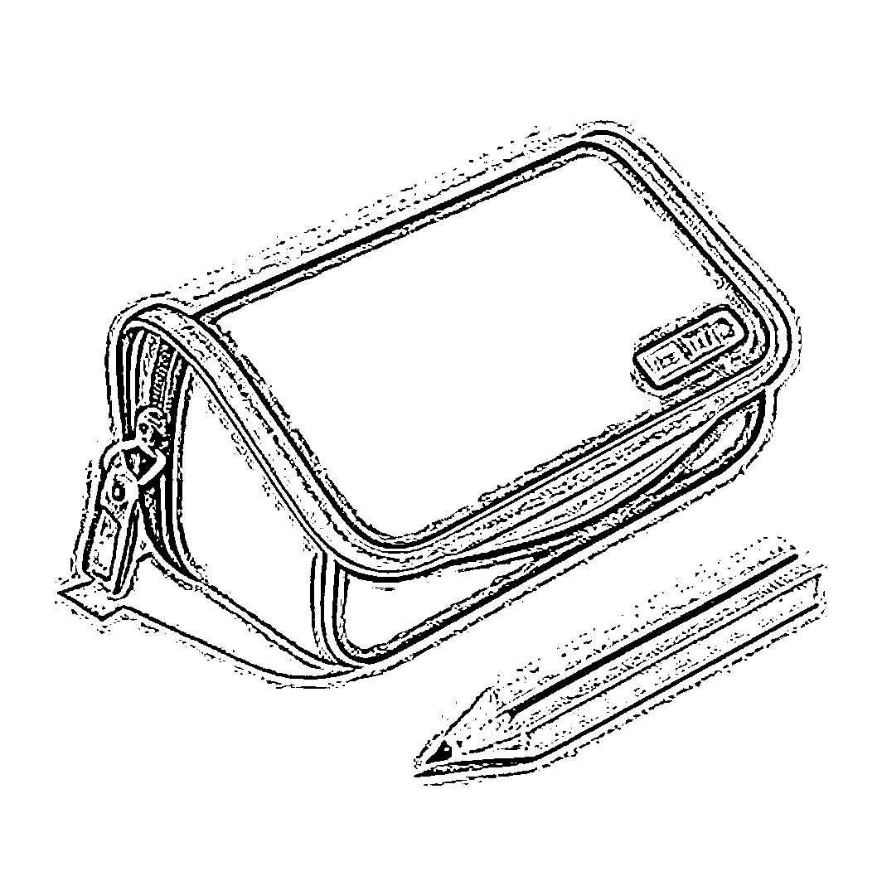
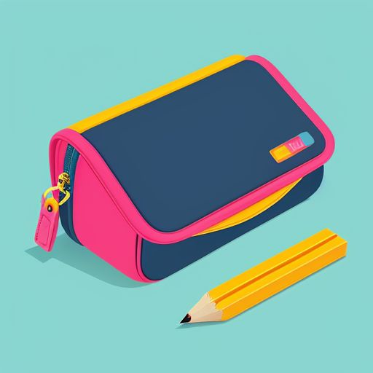
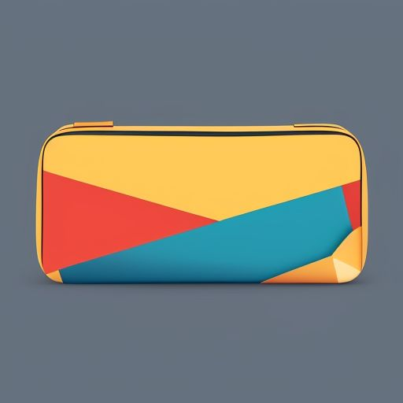
Trace & Color
My School Bag
Pencil Pouch

Slide 11



Trace & Color
My School Bag
Crayon

Slide 12
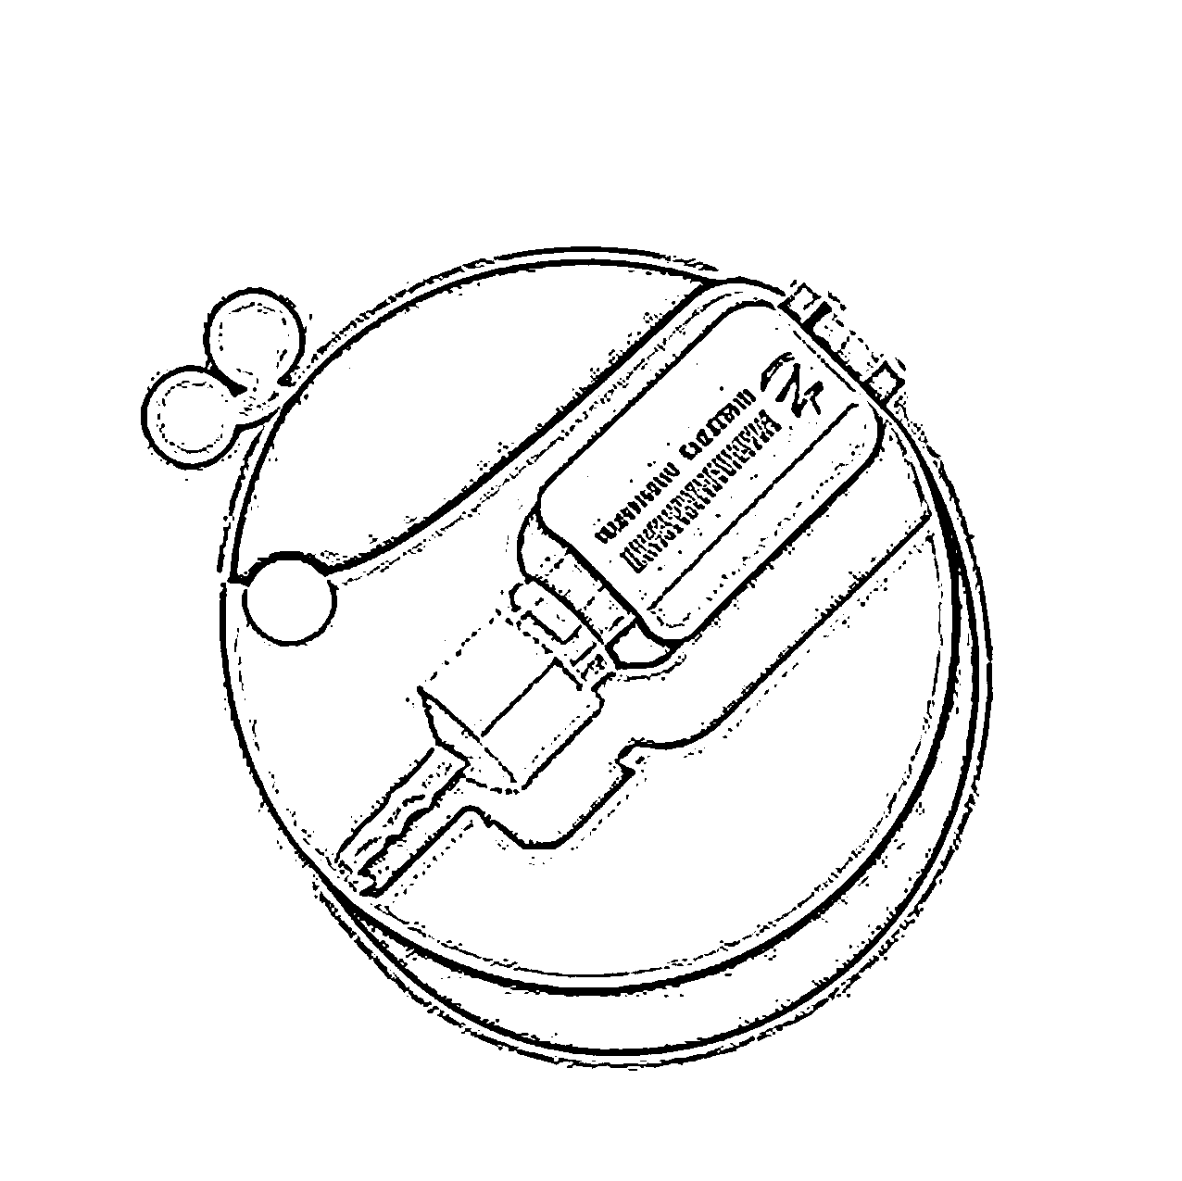

Trace & Color
My School Bag
Glue

Slide 13
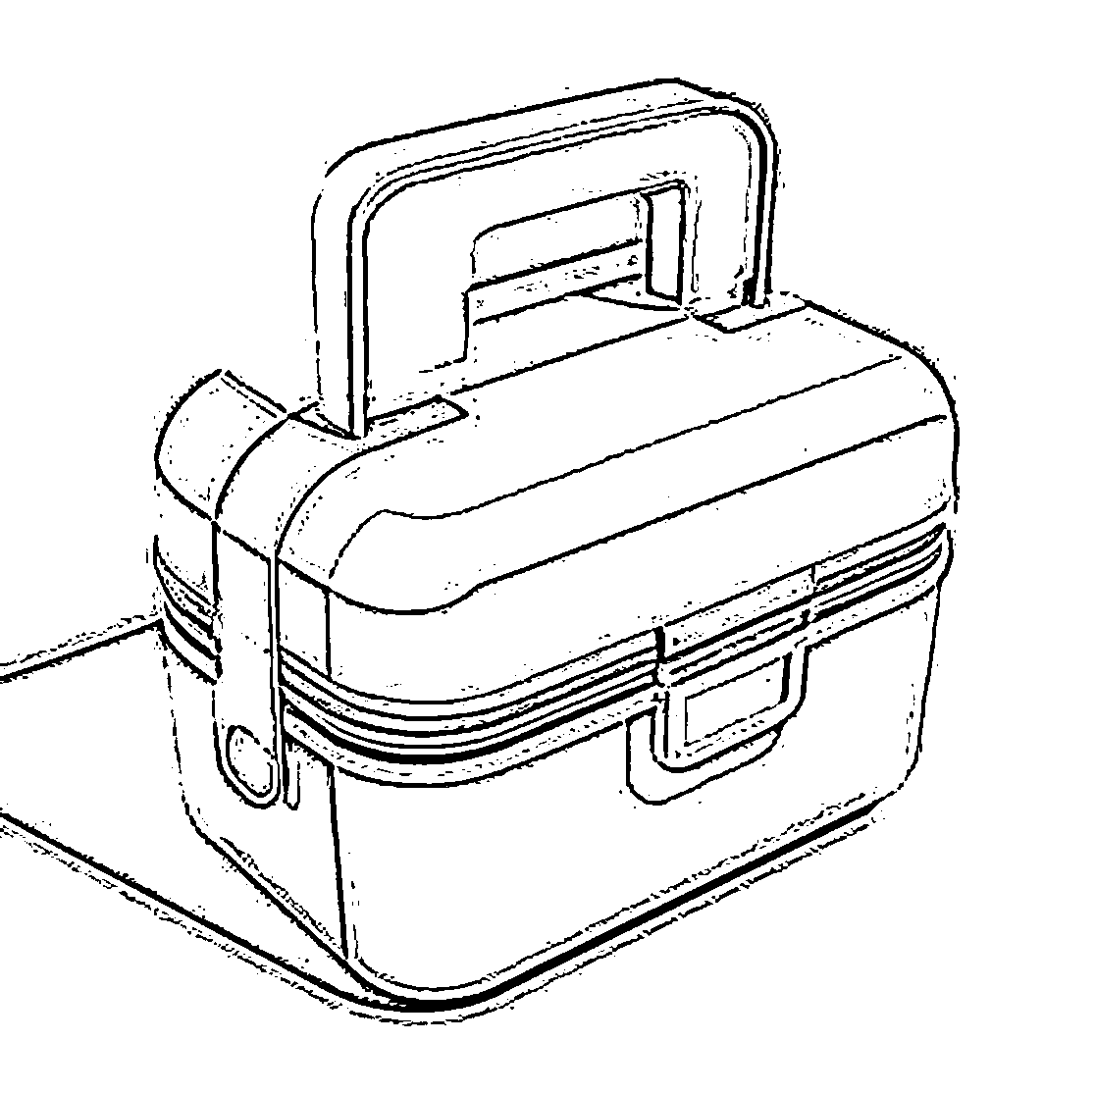


Trace & Color
My School Bag
Lunch Box

